Slide 1
Telecom domain
POWER BI PROJECT

Slide 2
PROBLEM STATEMENT
AtliQ is one of the leading telecom providers in India and launched its 5G plans in May 2022 along with other telecom providers.
However, the management noticed a decline in their active users and revenue growth post 5G launch in May 2022. AtliQ’s business director requested their analytics team to provide a comparison report of KPIs between pre and post-periods of the 5G launch. The management is keen to compare the performance between these periods and get insights that would enable them to make informed decisions to recover their active user rate and other key metrics.

Slide 3
KPI FOR TELECOM DOMAIN
Total Revenue
Avg. Revenue
Average Revenue Per User (ARPU)
Total Active Users
Total Unsubscribed Users
Market Share %
Revenue Before 5G
Revenue After 5G
ARPU Before 5G
ARPU After 5G
Active Users Before 5G
Active Users After 5G
Unsubscribed users Before 5G
Unsubscribed users After 5G

Slide 4
Data duration
Data available for following Time Frame:-
Before 5G
After 5G
Jan, Feb, Mar & Apr
May, Jun, Jul & Aug
2022
2022

Slide 5
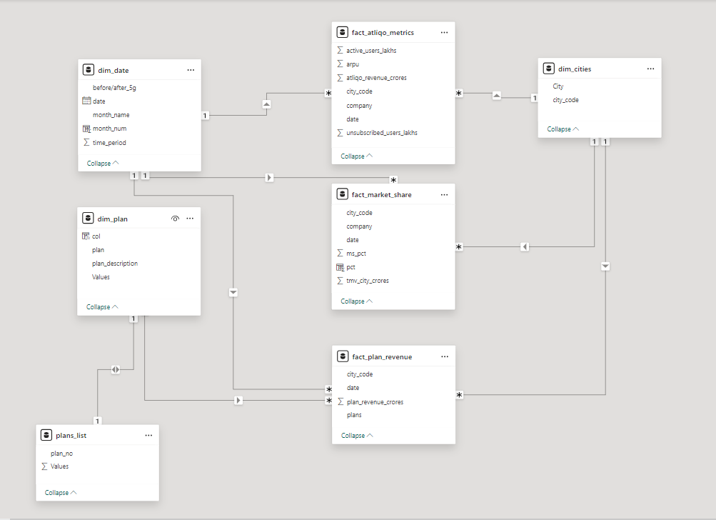
DATA MODELLING :-
FACT Table

Slide 6
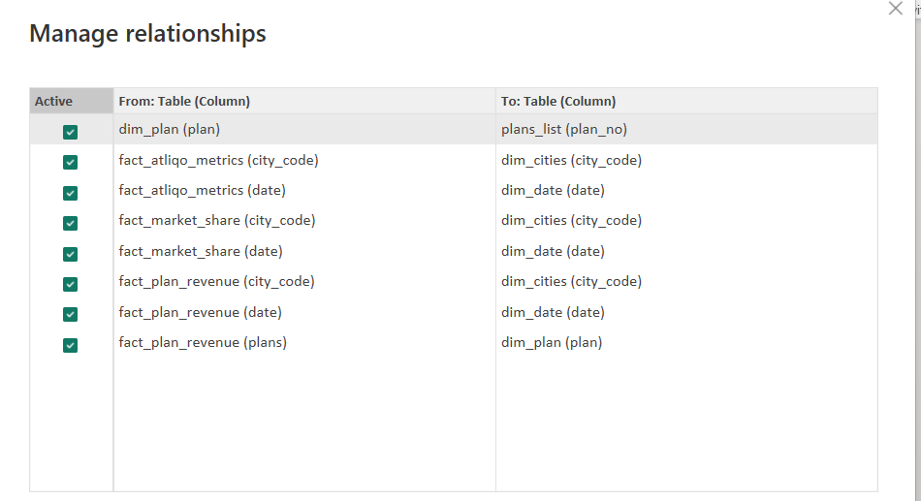
RELATIONSHIPS (One to Many):-

Slide 7
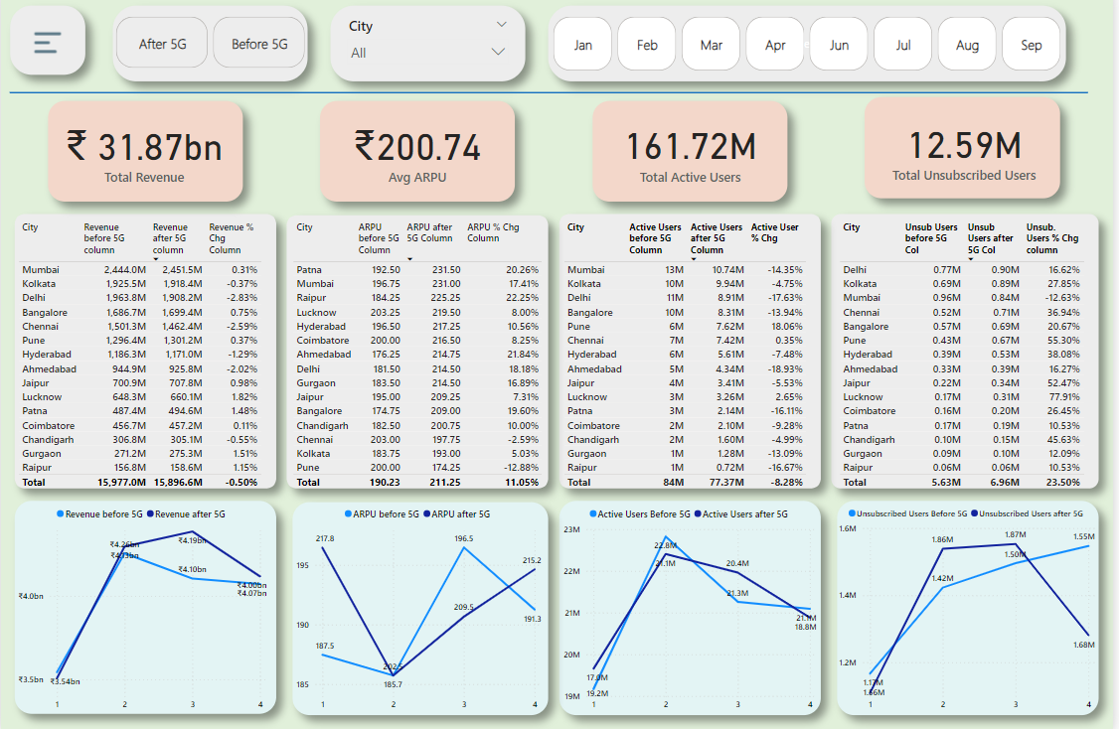
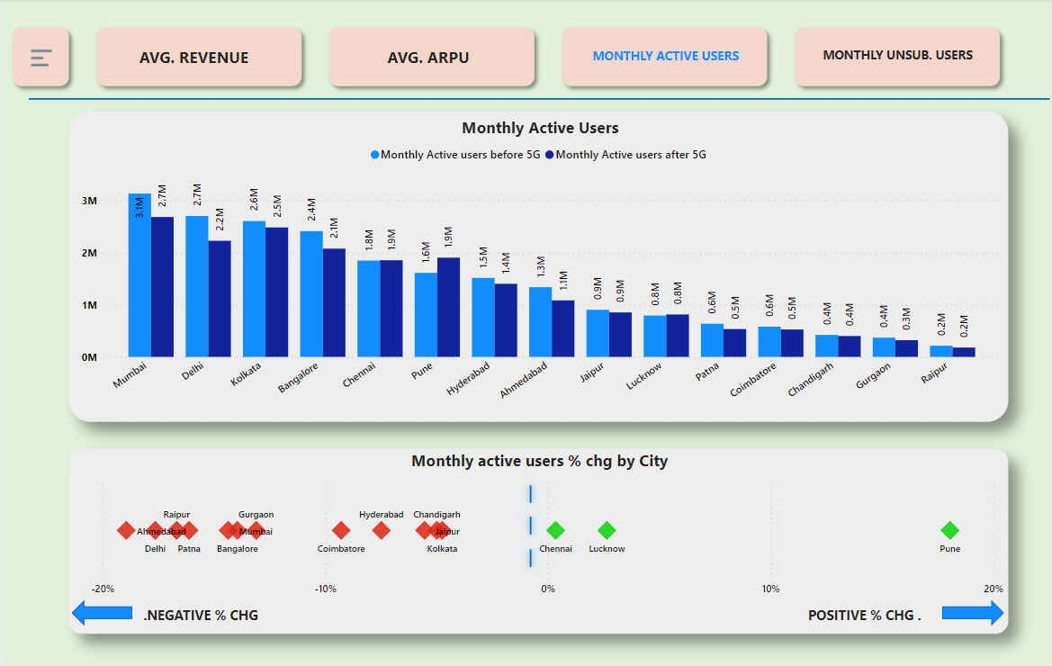
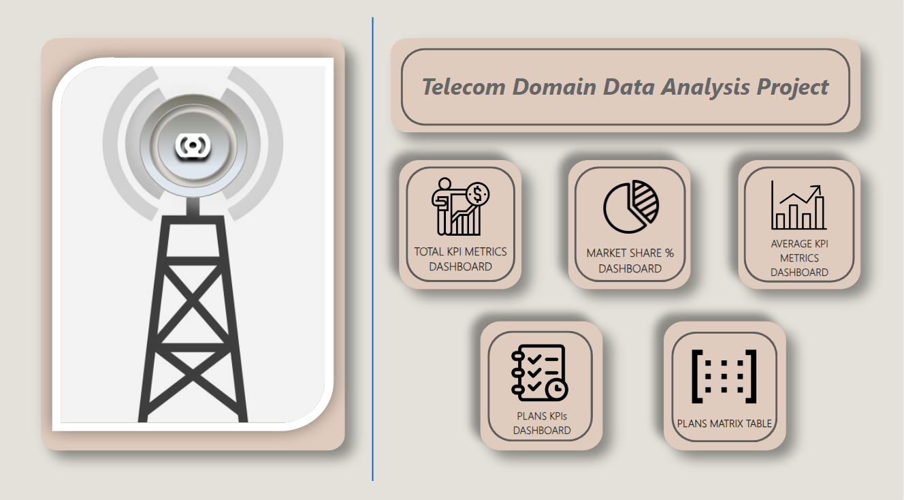
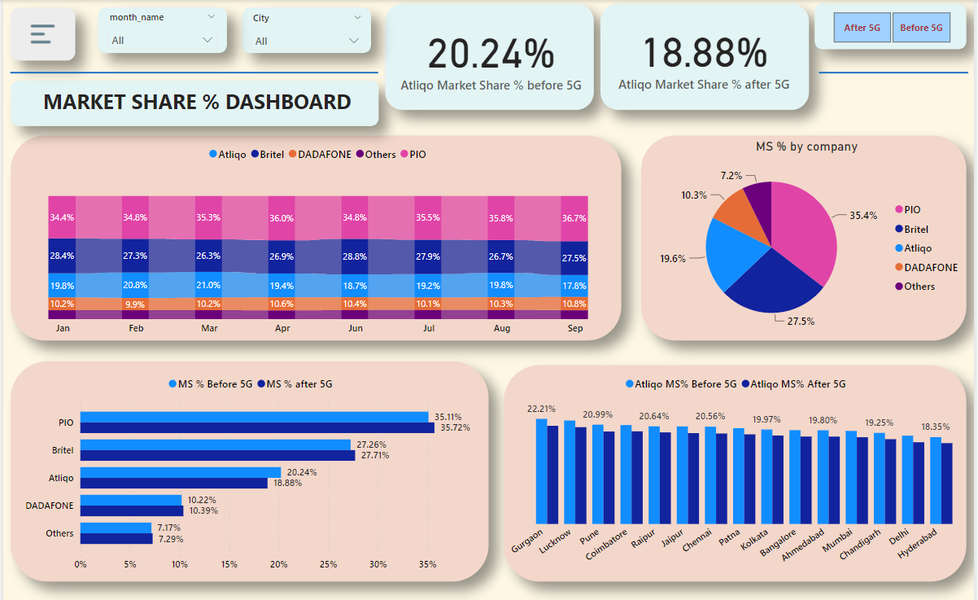
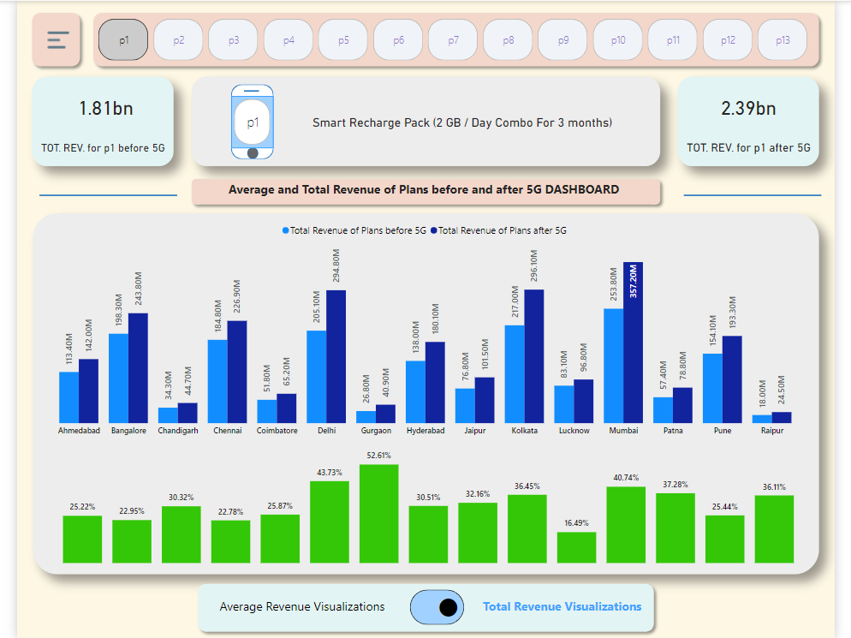
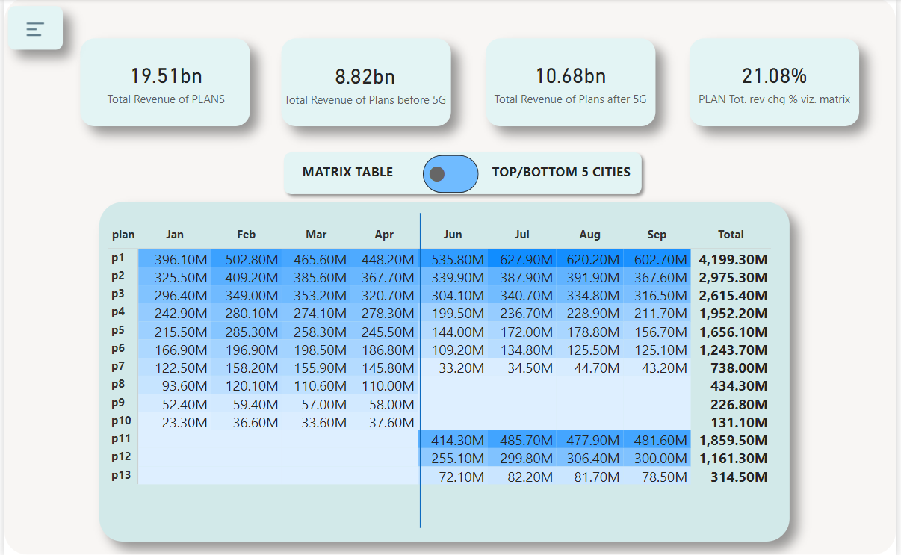
Total KPIs Dashboard
Avg. KPIs Dashboard
Home Page Dashboard
Market Share % Dashboard
Plans KPIs Dashboard
Matrix/Top & Bottom N Dashboard

